Slide 1

Competing risk models and a review
Steve Simon for
Notes:
Analyzing Repeated Measures Data Workshop: Module 5 The Linear Mixed Model
Copyright 2011 The Analysis Factor http://TheAnalysisFactor.com
1

Slide 2
Abstract
Lecture 8.
Lecture 8. Competing risk models. If you have multiple causes of death, you can track them simultaneously using a competing risk model. The completing risk model insures that the probability of death from any cause cannot exceed 1. You will see how to fit a competing risk model and display the results.

Slide 3
The leader data set
Overview
This data set tracks leaders of countries of the world and how long they stay in power. Leaders can be removed by constitutional means, by natural death, or by nonconstitutional means (military coup or assassination, for example). This data set is restricted to 1960 through 1987, and does not include North America.

Slide 4
The leader data set
Variables
years Min. 1st Qu. Median Mean 3rd Qu. Max.
0.000 1.000 3.000 5.114 7.000 27.000
lost still in power constitutional exit
111 146
natural death nonconstitutional exit
27 154

Slide 5
The leader data set
Variables
manner constitutional ascent
280
nonconstitutional ascent
158
start Min. 1st Qu. Median Mean 3rd Qu. Max.
1960 1965 1973 1973 1979 1987
military no yes
294 144

Slide 6
The leader data set
Variables
age Min. 1st Qu. Median Mean 3rd Qu. Max.
17.00 41.00 50.00 49.39 56.75 81.00
conflict low conflict medium/high conflict
166 272
loginc Min. 1st Qu. Median Mean 3rd Qu. Max.
4.094 5.075 5.858 5.916 6.565 9.546

Slide 7
The leader data set
Variables
growth Min. 1st Qu. Median Mean 3rd Qu. Max.
-7.00 0.50 1.50 1.63 3.40 8.50
pop Min. 1st Qu. Median Mean 3rd Qu. Max.
0.008 2.600 7.000 35.780 24.000 1088.000
Land Min. 1st Qu. Median Mean 3rd Qu. Max.
0.02 49.00 238.00 739.97 912.00 9596.00

Slide 8
The leader data set
Variables
literacy Min. 1st Qu. Median Mean 3rd Qu. Max.
5 32 65 59.41 85 99
region middle east africa
60 132
asia latin america
91 155

Slide 9
The leader data set
Check for sufficient number of events in each group
manner 0 1
constitutional ascent 70 210
nonconstitutional ascent 41 117
military 0 1
no 70 224
yes 41 103

Slide 10
The leader data set
Check for sufficient number of events in each group
conflict 0 1
low conflict 42 124
medium/high conflict 69 203
region 0 1
middle east 18 42
africa 42 90
asia 26 65
latin america 25 130

Slide 11
The leader data set
Create cut-points for continuous variables
start_c 60s 70s 80s
176 159 103
age_c 0-39 40-59 60+
89 265 84
loginc_c $0-200 $200-500 $500+
130 149 159

Slide 12
The leader data set
Create cut-points for continuous variables
growth_c neg 0-3.9% 4%+
85 275 78
pop_c under 1m 1-10m 10m+
70 189 179

Slide 13
The leader data set
Create cut-points for continuous variables
land_c under 100 sq km 98
100-1,000 sq km 142
1,000-10,000 sq km 198
literacy_c 0-50% 50-75% 75-100%
163 103 172

Slide 14
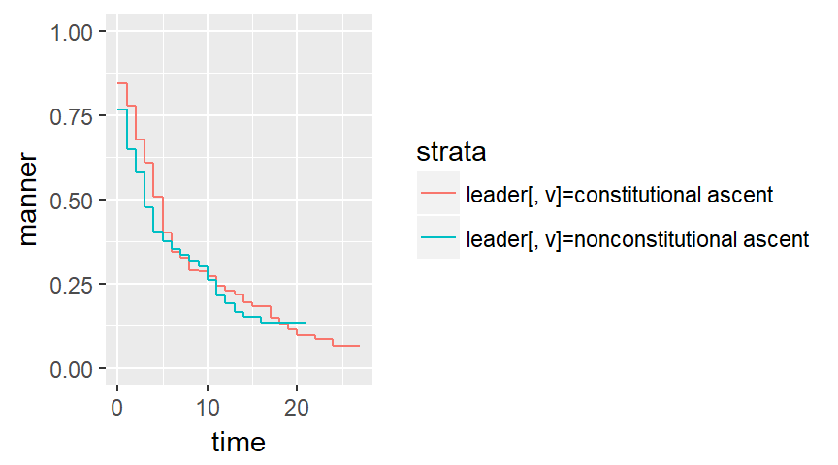
The leader data set, Kaplan-Meier curves

Slide 15
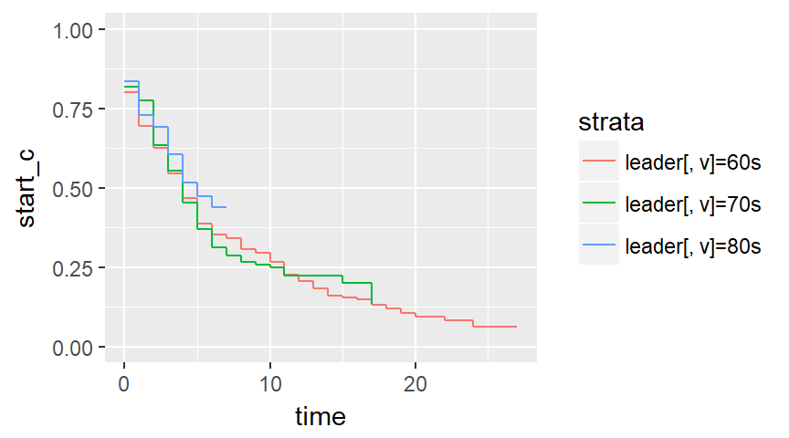
The leader data set, Kaplan-Meier curves

Slide 16
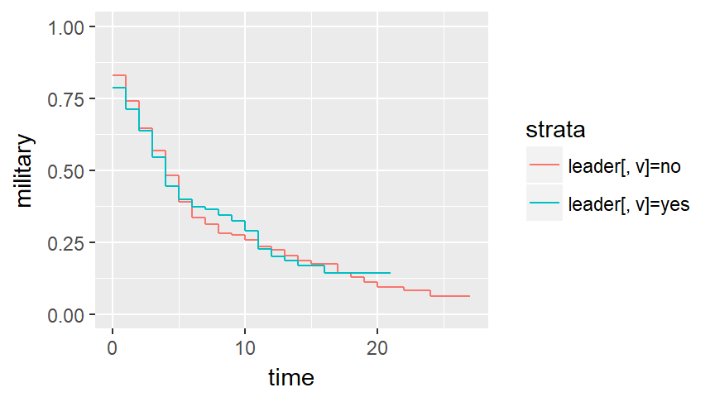
The leader data set, Kaplan-Meier curves

Slide 17
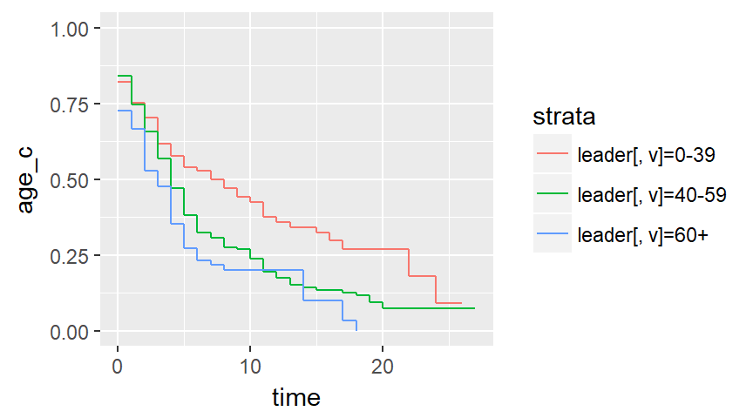
The leader data set, Kaplan-Meier curves

Slide 18
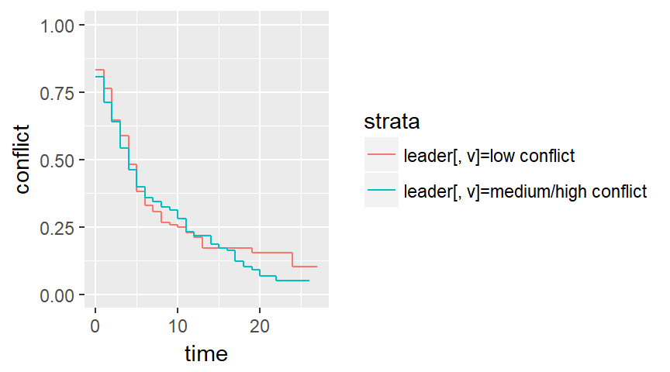
The leader data set, Kaplan-Meier curves

Slide 19
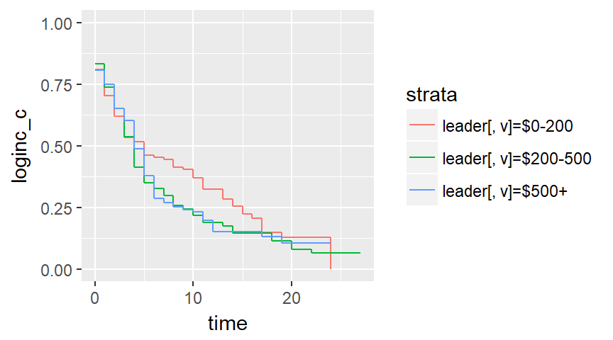
The leader data set, Kaplan-Meier curves

Slide 20
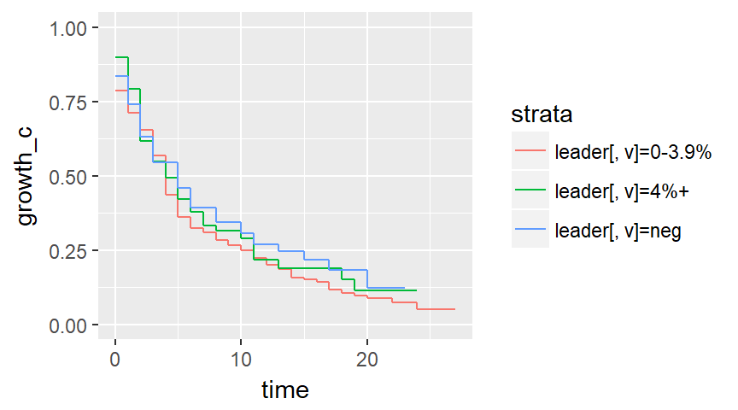
The leader data set, Kaplan-Meier curves

Slide 21
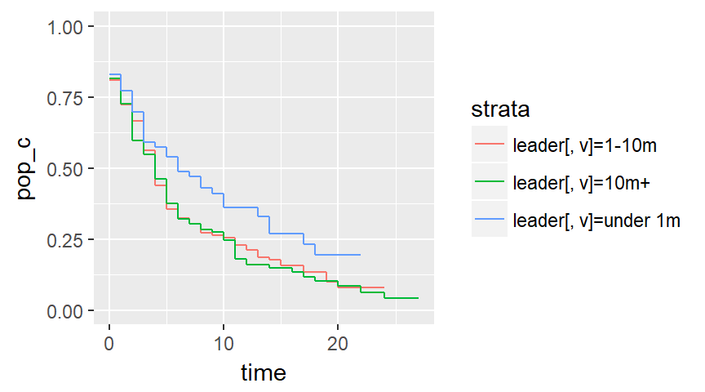
The leader data set, Kaplan-Meier curves

Slide 22
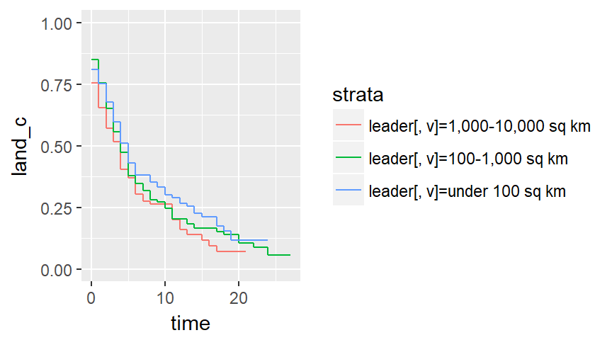
The leader data set, Kaplan-Meier curves

Slide 23
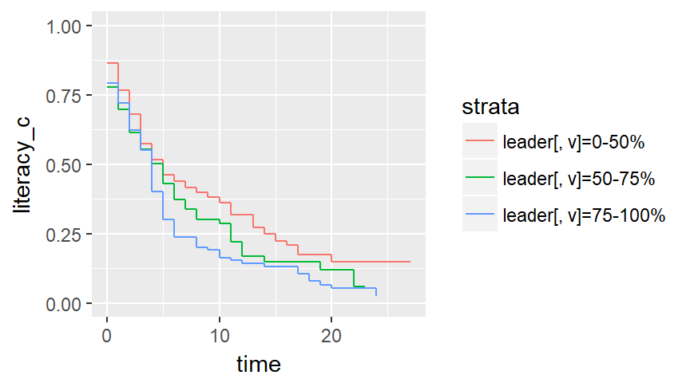
The leader data set, Kaplan-Meier curves

Slide 24
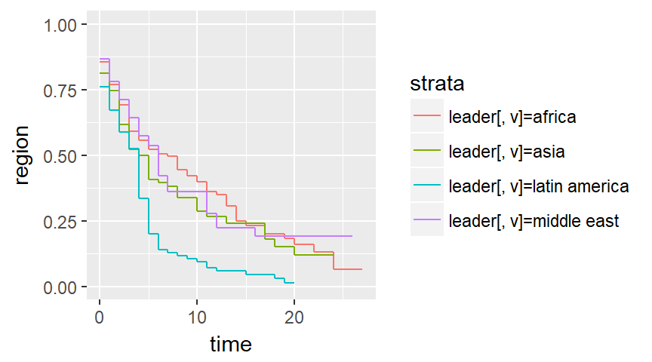
The leader data set, Kaplan-Meier curves

Slide 25
The leader data set
Run univariate Cox models
coef exp(coef) se(coef) z p
manner 0.138 1.148 0.116 1.19 0.23
coef exp(coef) se(coef) z p
military -0.00827 0.99176 0.11949 -0.07 0.94
coef exp(coef) se(coef) z p
age 0.02170 1.02194 0.00482 4.51 6.6e-06

Slide 26
The leader data set
Run a multivariate Cox model
coef exp(coef) se(coef) z p-v
manner 0.359963 1.433277 0.153237 2.349 0.0188
military -0.128457 0.879451 0.157289 -0.817 0.4141
age 0.024148 1.024442 0.004967 4.862 0.0001

Slide 27
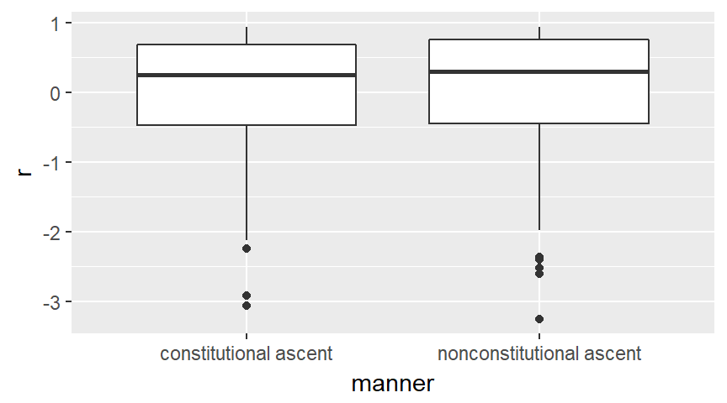
The leader data set, Martingale residuals

Slide 28
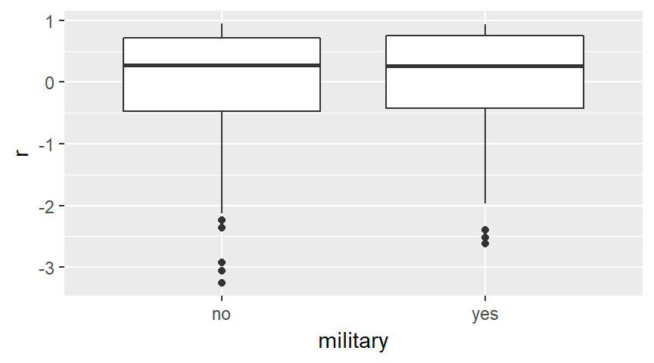
The leader data set, Martingale residuals

Slide 29
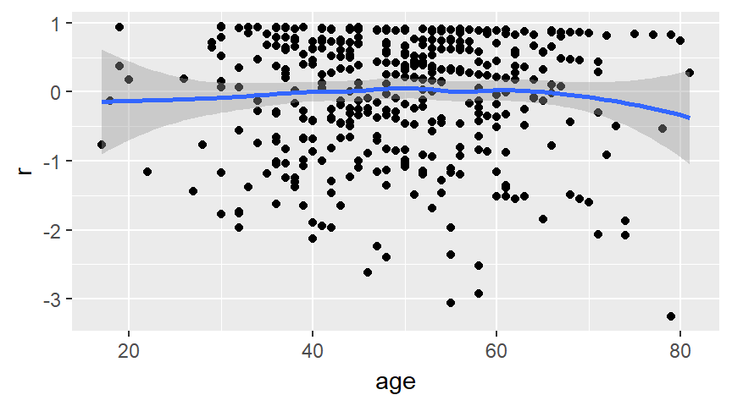
The leader data set, Martingale residuals

Slide 30
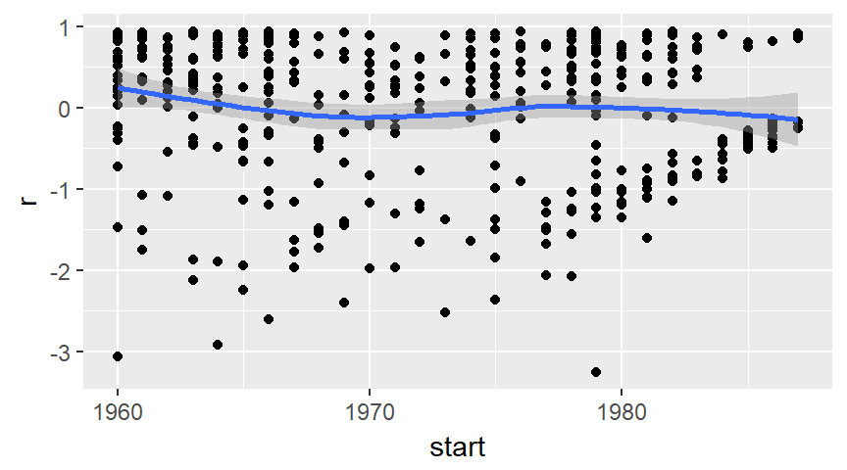
The leader data set, Martingale residuals

Slide 31
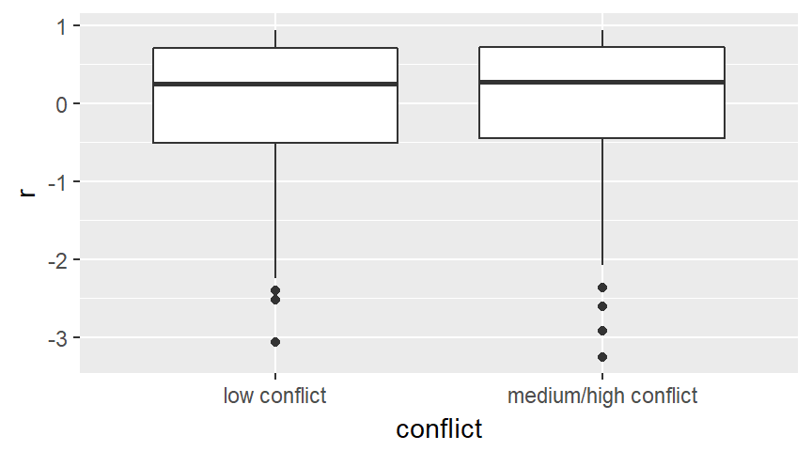
The leader data set, Martingale residuals

Slide 32
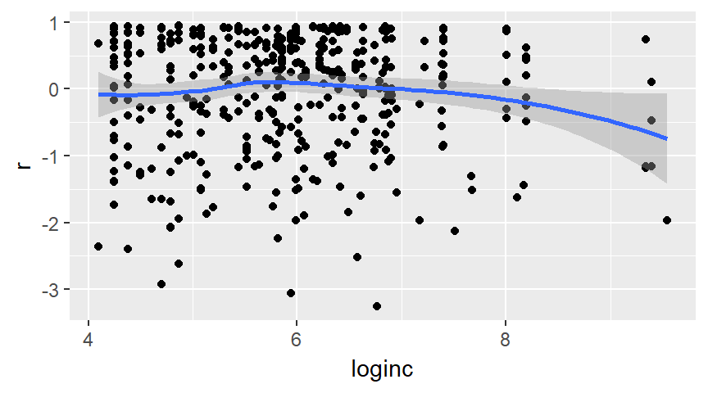
The leader data set, Martingale residuals

Slide 33
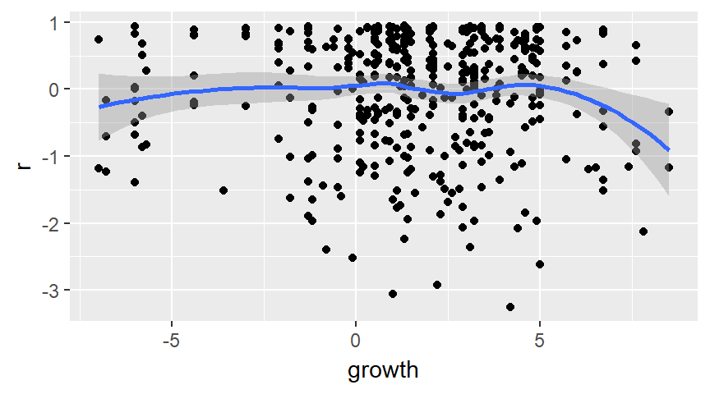
The leader data set, Martingale residuals

Slide 34
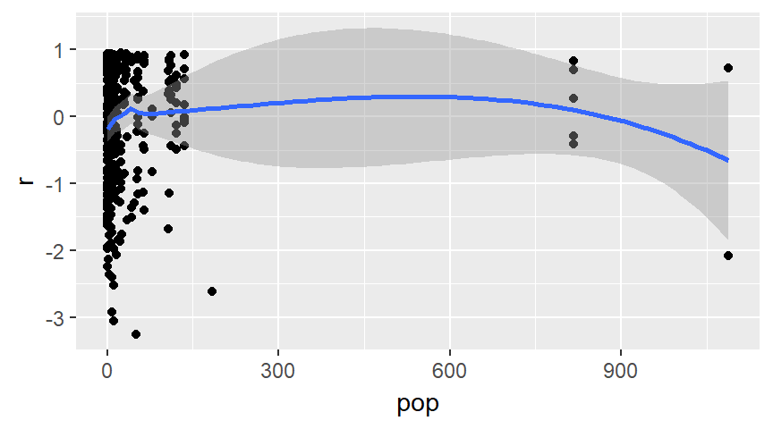
The leader data set, Martingale residuals

Slide 35
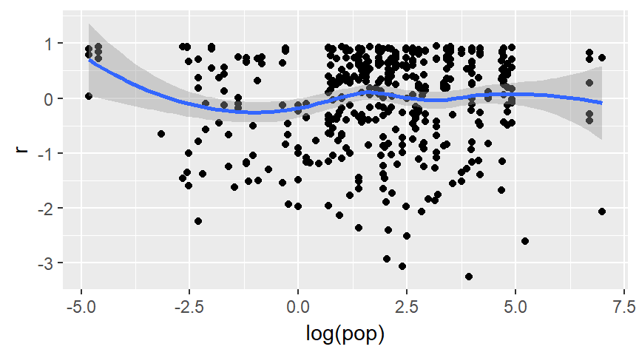
The leader data set, Martingale residuals

Slide 36
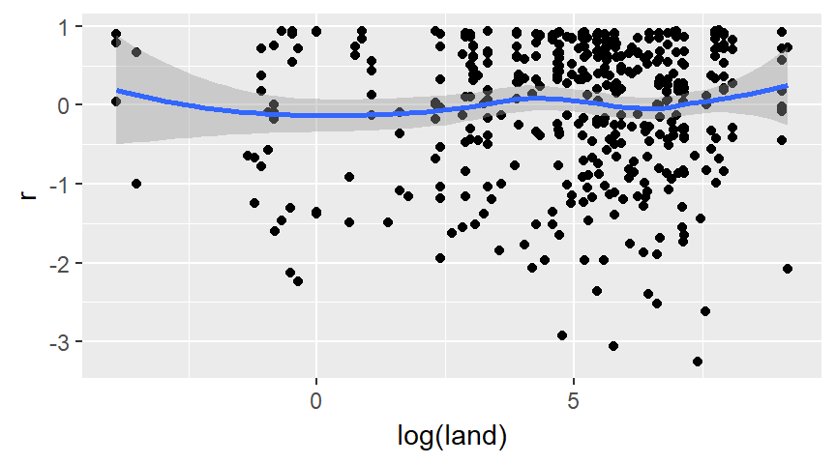
The leader data set, Martingale residuals

Slide 37
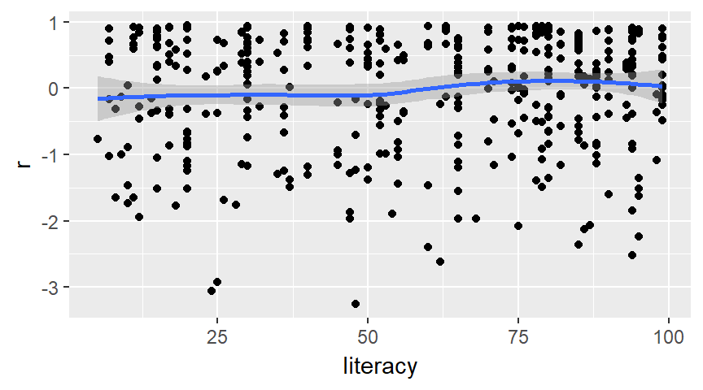
The leader data set, Martingale residuals

Slide 38
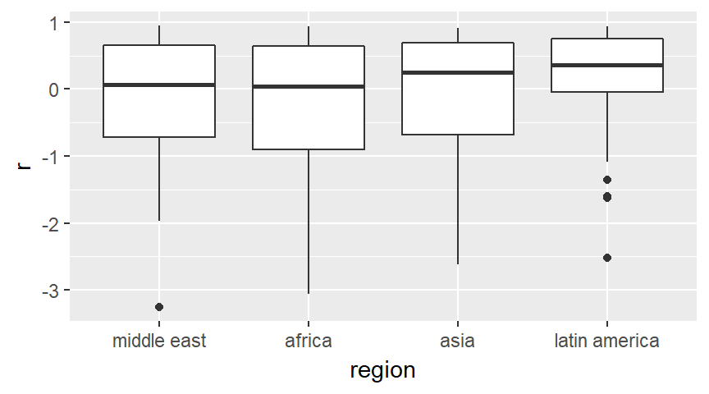
The leader data set, Martingale residuals

Slide 39
The leader data set
Revise your multivariate Cox model
coef exp(coef) se(coef) z Pr(>|z|)
manner 0.34961 1.41851 0.15279 2.288 0.02213
military -0.20673 0.81324 0.15670 -1.319 0.18706
age 0.02230 1.02255 0.00514 4.339 1.43e-05
loginc -0.18795 0.82866 0.07040 -2.670 0.00759
i_africa -0.37780 0.68537 0.21571 -1.751 0.07986
i_asia -0.21214 0.80885 0.22368 -0.948 0.34292
i_lat_am 0.51930 1.68085 0.18143 2.862 0.00421

Slide 40
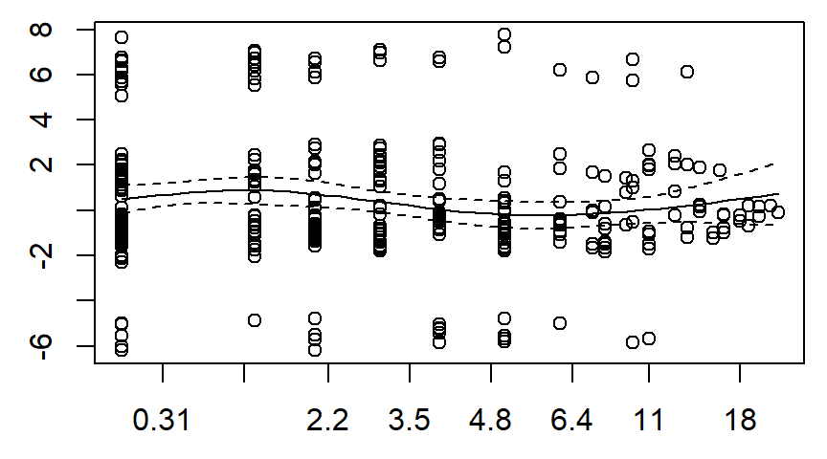
The leader data set, Schoenfeld residuals

Slide 41
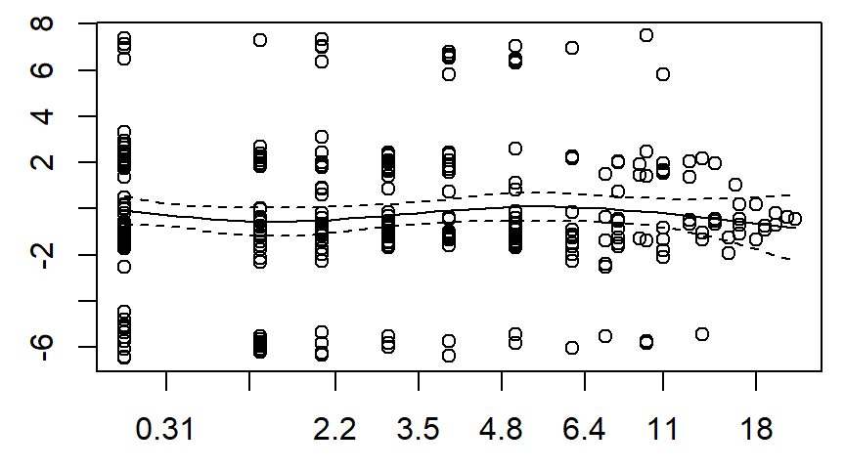
The leader data set, Schoenfeld residuals

Slide 42
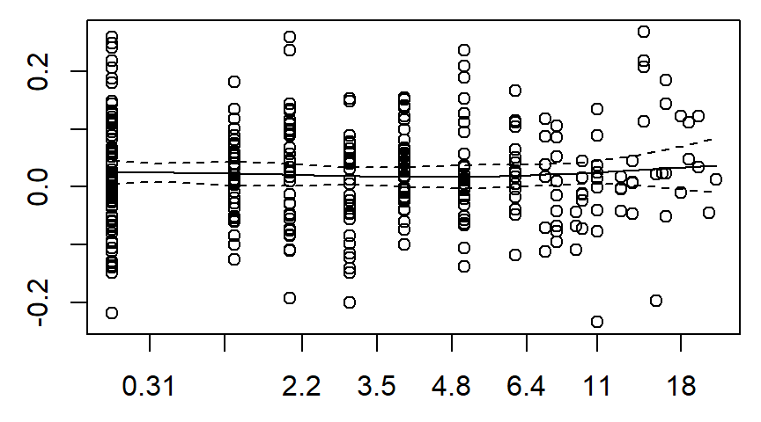
The leader data set, Schoenfeld residuals

Slide 43
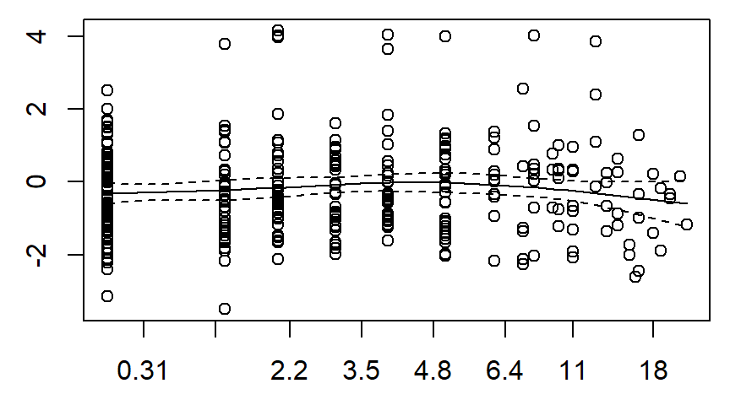
The leader data set, Schoenfeld residuals

Slide 44
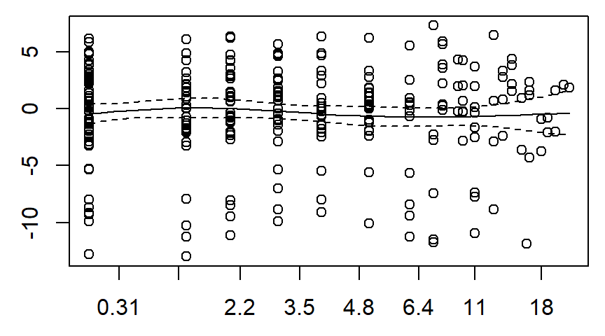
The leader data set, Schoenfeld residuals

Slide 45
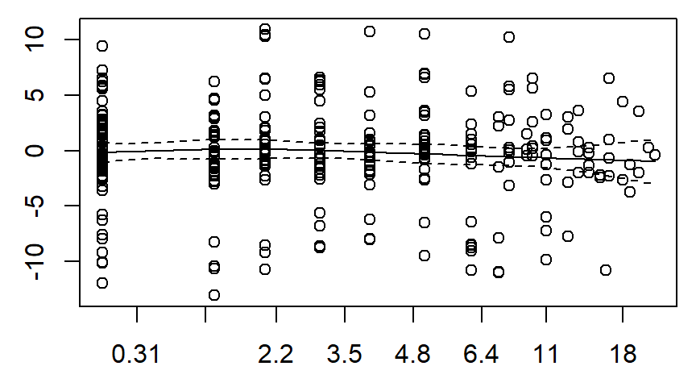
The leader data set, Schoenfeld residuals

Slide 46
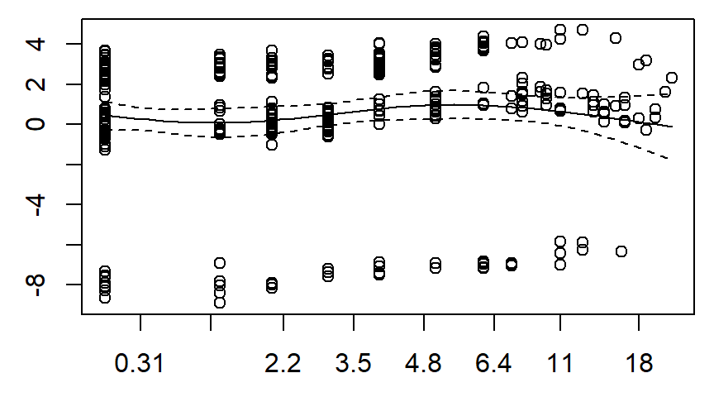
The leader data set, Schoenfeld residuals

Slide 47
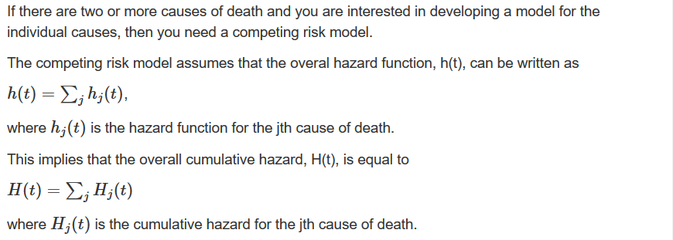
The competing risks model

Slide 48
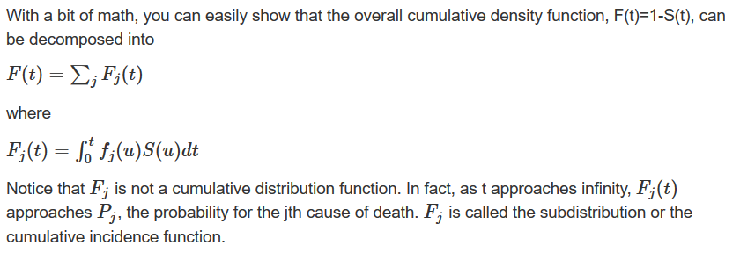
The competing risks model

Slide 49
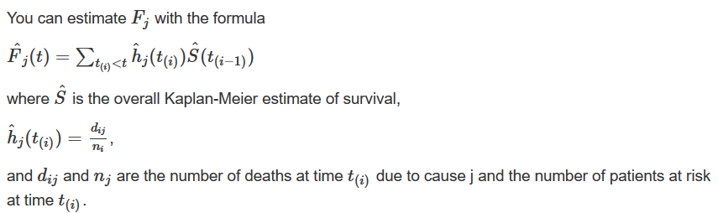
The competing risks model

Slide 50
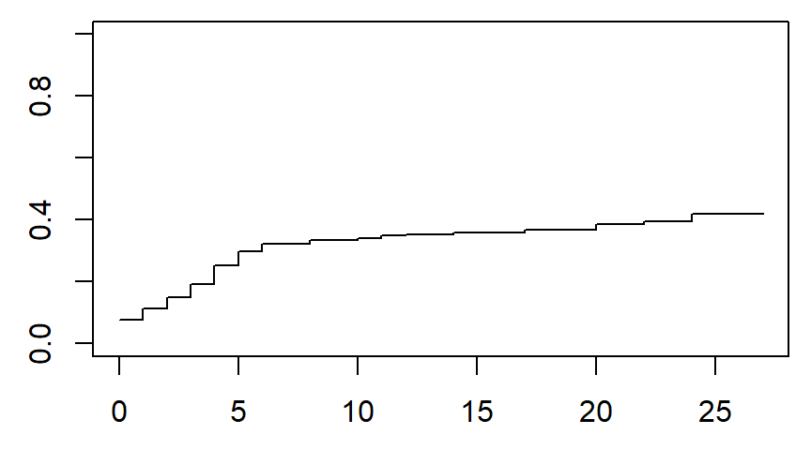
Competing risks, constitutional exit

Slide 51
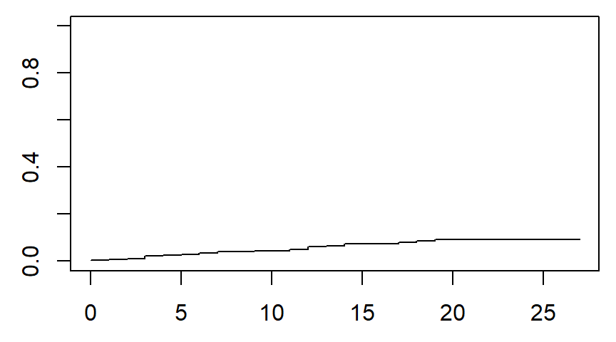
Competing risks, natural death

Slide 52
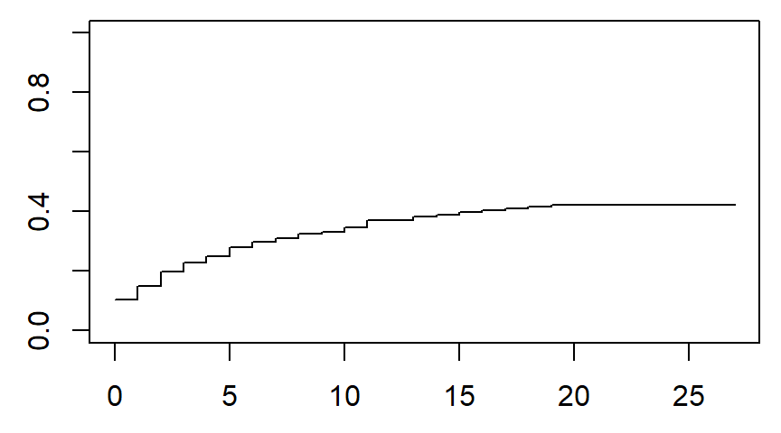
Competing risks, nonconstitutional exit

Slide 53
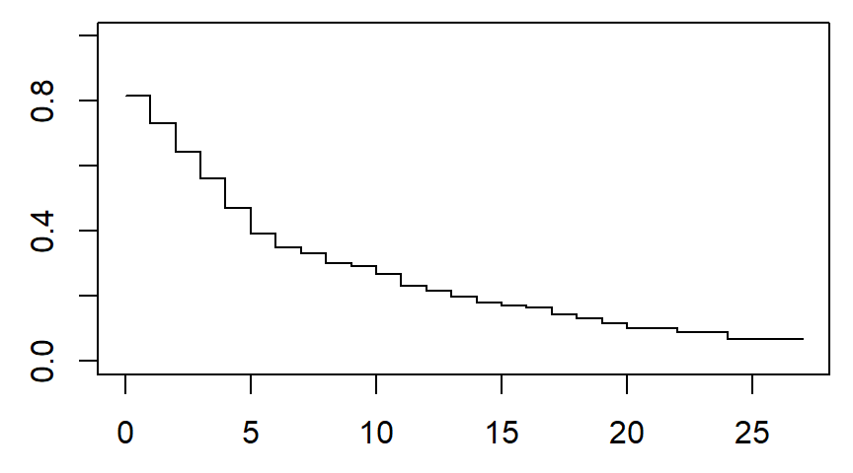
Competing risks, probability of no exit

Slide 54
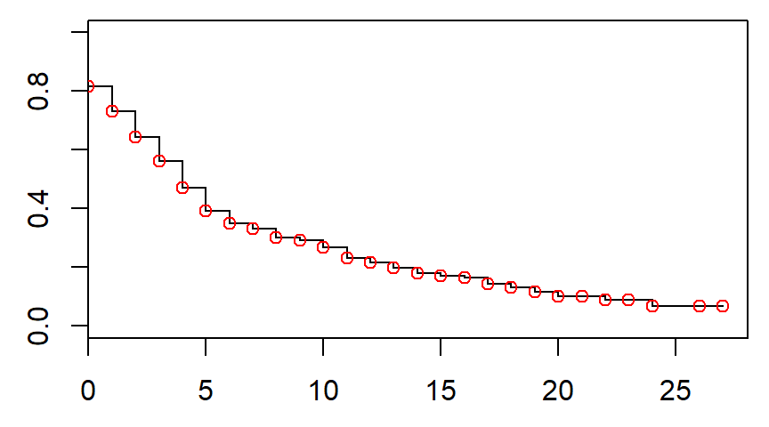
Probability of no exit matches overall survival

Slide 55
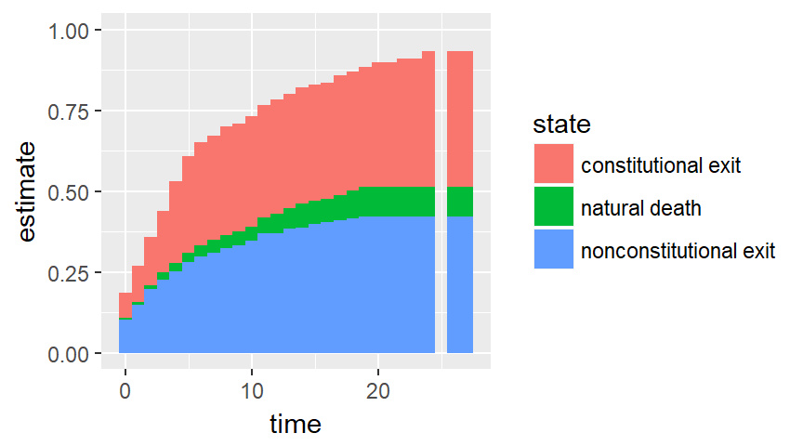
The leader data set, competing risks

Slide 56
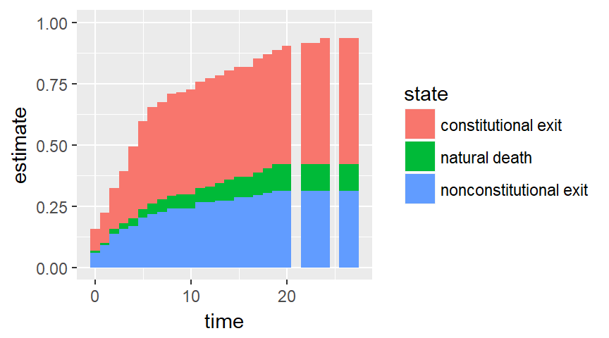
The leader data set, competing risks

Slide 57
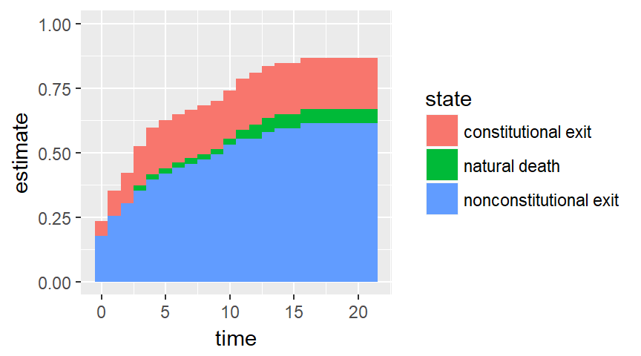
The leader data set, competing risks

Slide 58
Conclusion
What have you learned today?
Steps in a typical survival model
Descriptive statistics
Counts
Simple Kaplan-Meier curves
Univariate Cox models
Multivariate Cox models
Martingale residuals
Schoenfeld residuals
Competing risk analysis

